Slide 1
Project Name: Car Price Prediction
Author: Laxmikant walzade

Slide 2
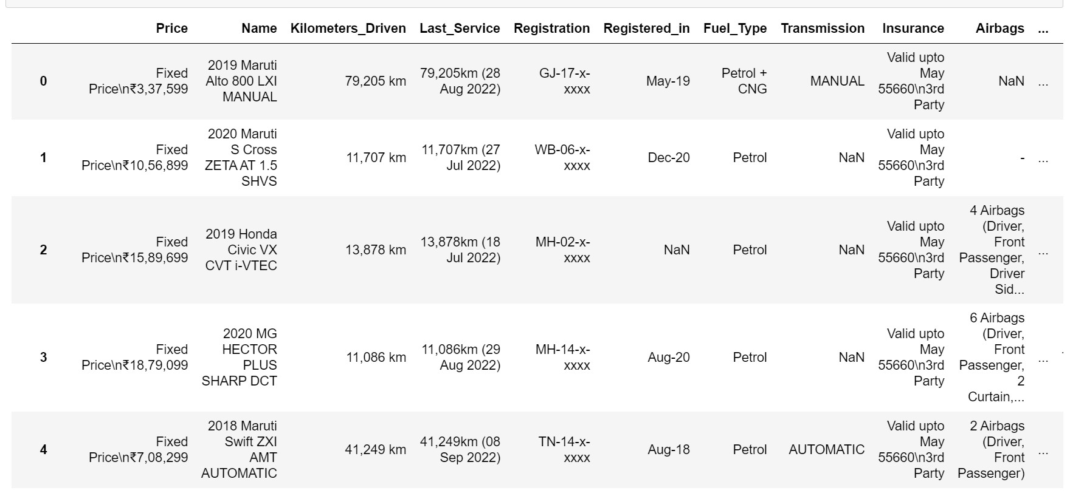
Problem Definition.
With the covid 19 impact in the market, we have seen lot of changes in the car market. Now some cars are in demand hence making them costly and some are not in demand hence cheaper. One of our clients works with small traders, who sell used cars. With the change in market due to covid 19 impact, our client is facing problems with their previous car price valuation machine learning models. So, they are looking for new machine learning models from new data. We have to make car price valuation model.
This dataset include following columns:-
'Price', 'Name', 'Kilometers_Driven', 'Last_Service', 'Registration', 'Registered_in', 'Fuel_Type', 'Transmission', 'Insurance', 'Airbags', 'Seat_Upholstery', 'Integrated_Music', 'Rear_View_Mirrors', 'Engine_start_stop', 'Central_Locking', 'Sunroof_Moonroof', 'Rear_AC', 'Power_Windows', 'Headlamps', 'Fuel_type', 'Engine_type', 'Drivetrain', 'Mileage', 'Steering_type', 'Transmission_type', 'Max_power', 'Fuel_tank_capacity', 'Seating_capacity', 'Alternate_fuel_type', 'History'
Data Analysis. DATASET
We have total 30 columns including the label i.e Price column.

Slide 3
Pre-Processing Steps
  Identifying sources of the data
  Analysing the information
  Cleaning and handling the information
  Selecting the most significant elements
  Writing down findings and observations
  Using various models to train the data
  Selecting the best-fitted model for predictions
8. Predicting results for test information

Slide 4
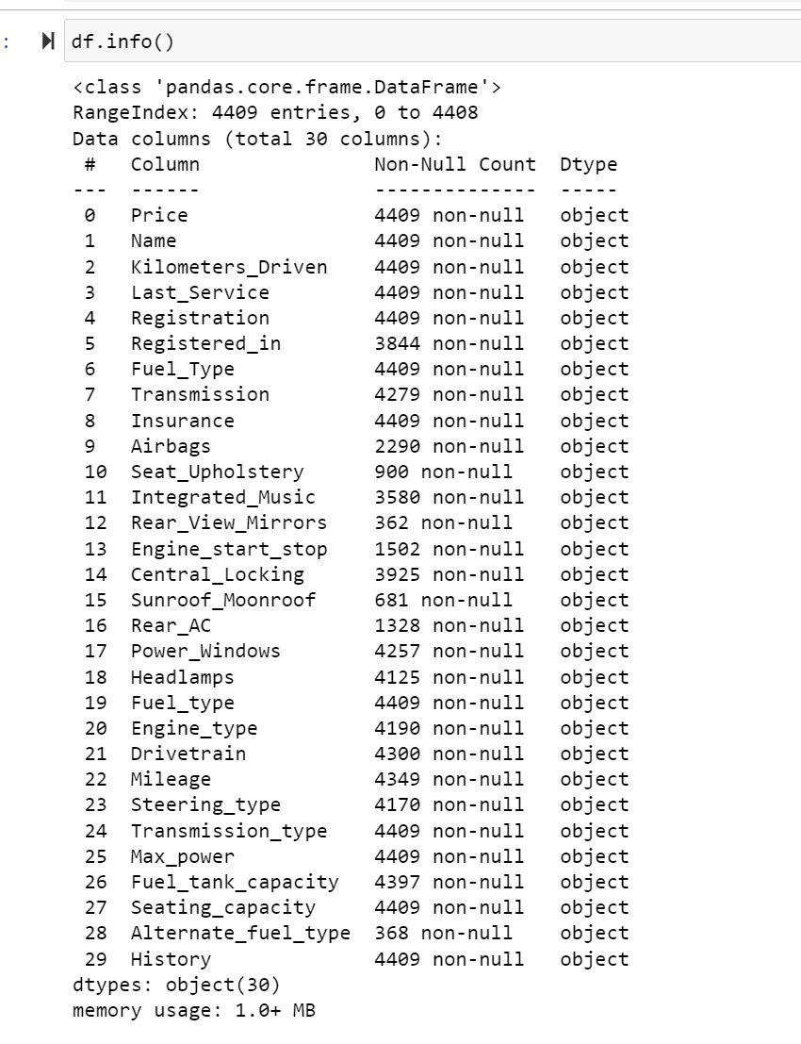
Pre-Processing Pipeline.
First let’s check the data type of the dataset.
All columns are Object type data which needs to change to Integer, since it is important for model building as model does not consider the string value.

Slide 5
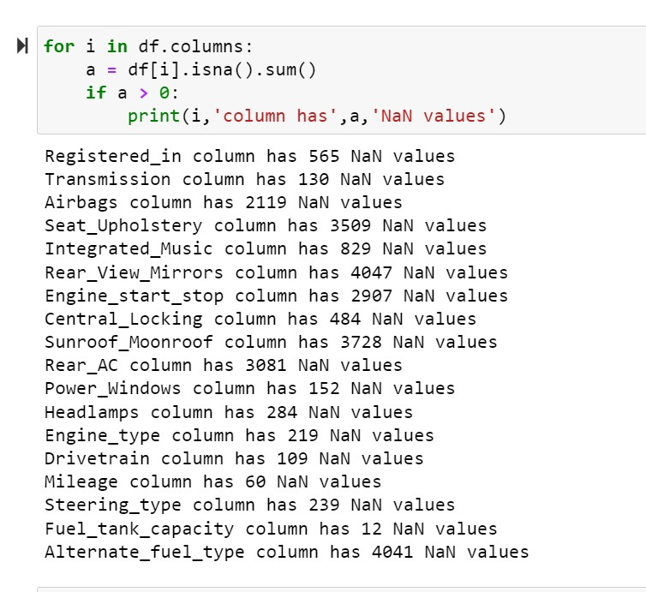
There are no Null Values present in the dataset so we can move further.
Sometimes some unwanted things can be found in a dataset which are equivalent to Null values. It is important to take care of such cases.

Slide 6
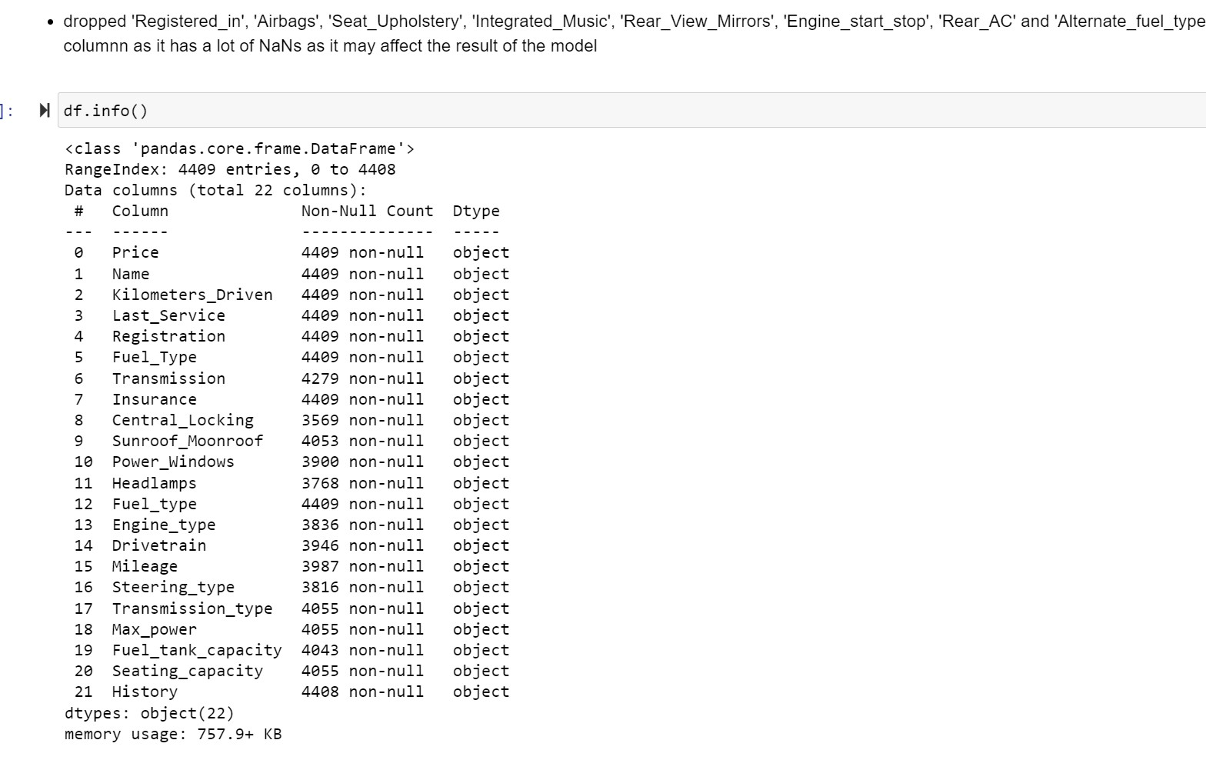
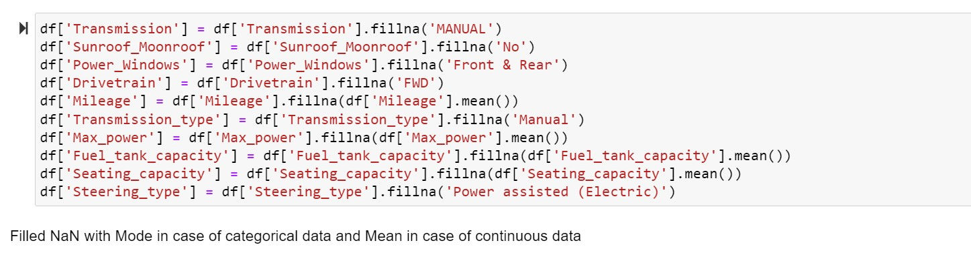
Need to clean and drop some columns
Filling the nan values
We have only 18 columns left after EDA

Slide 7
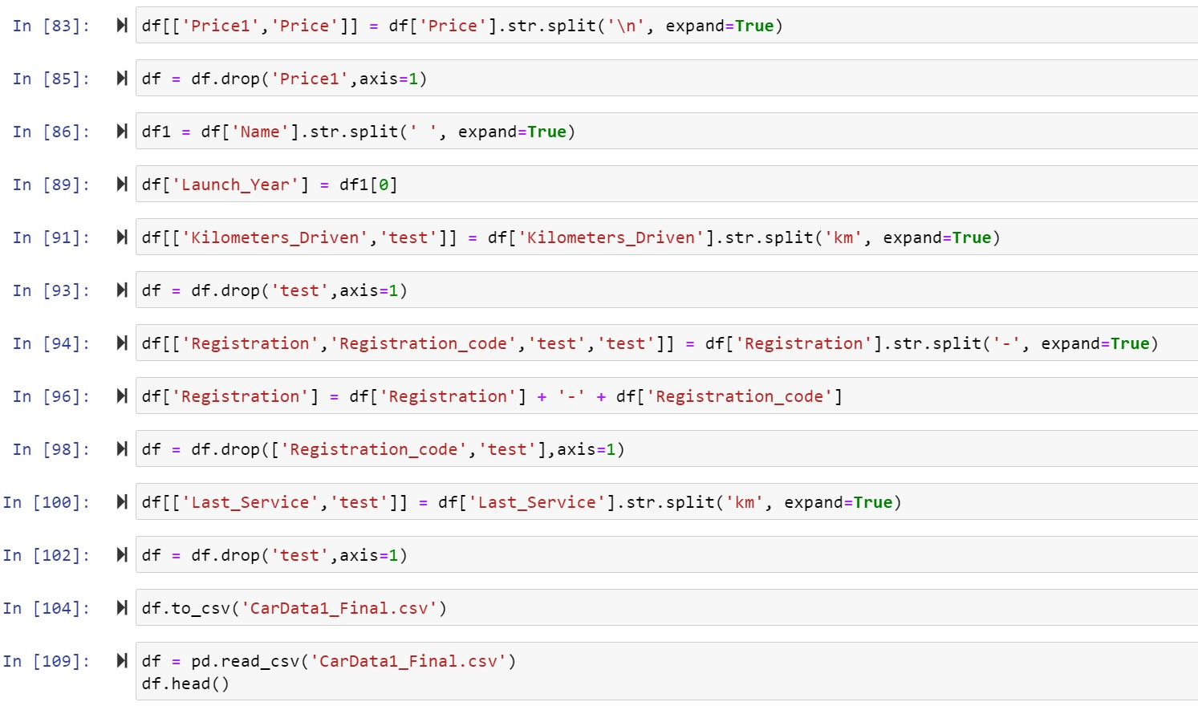
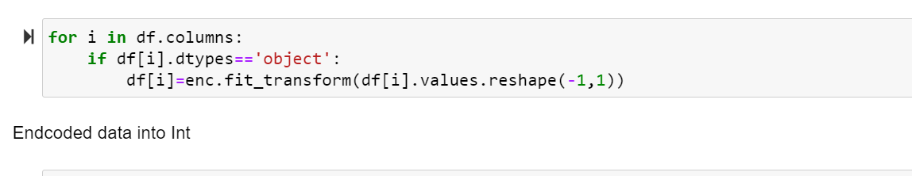
Data looks fine to encode into Int

Slide 8
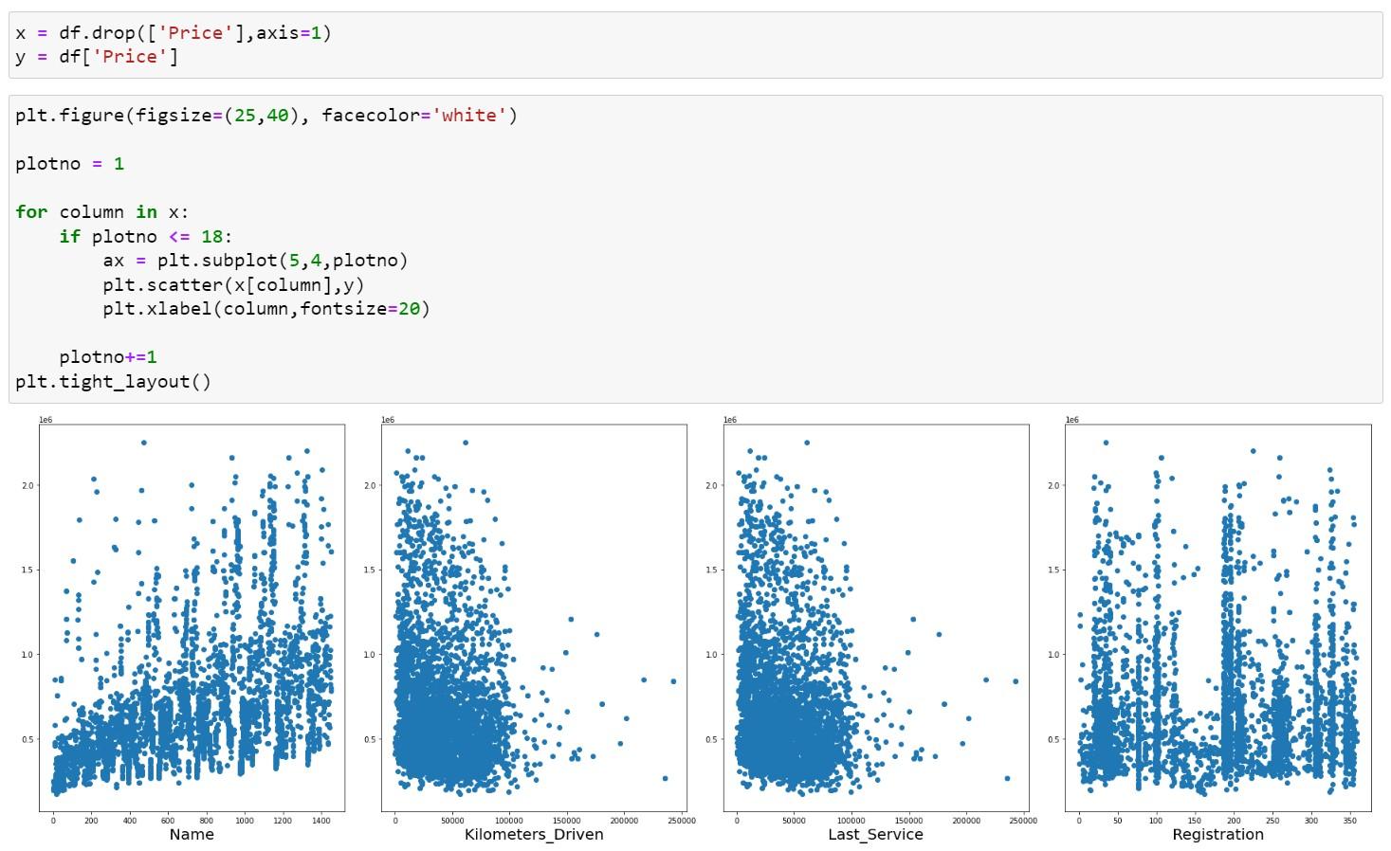
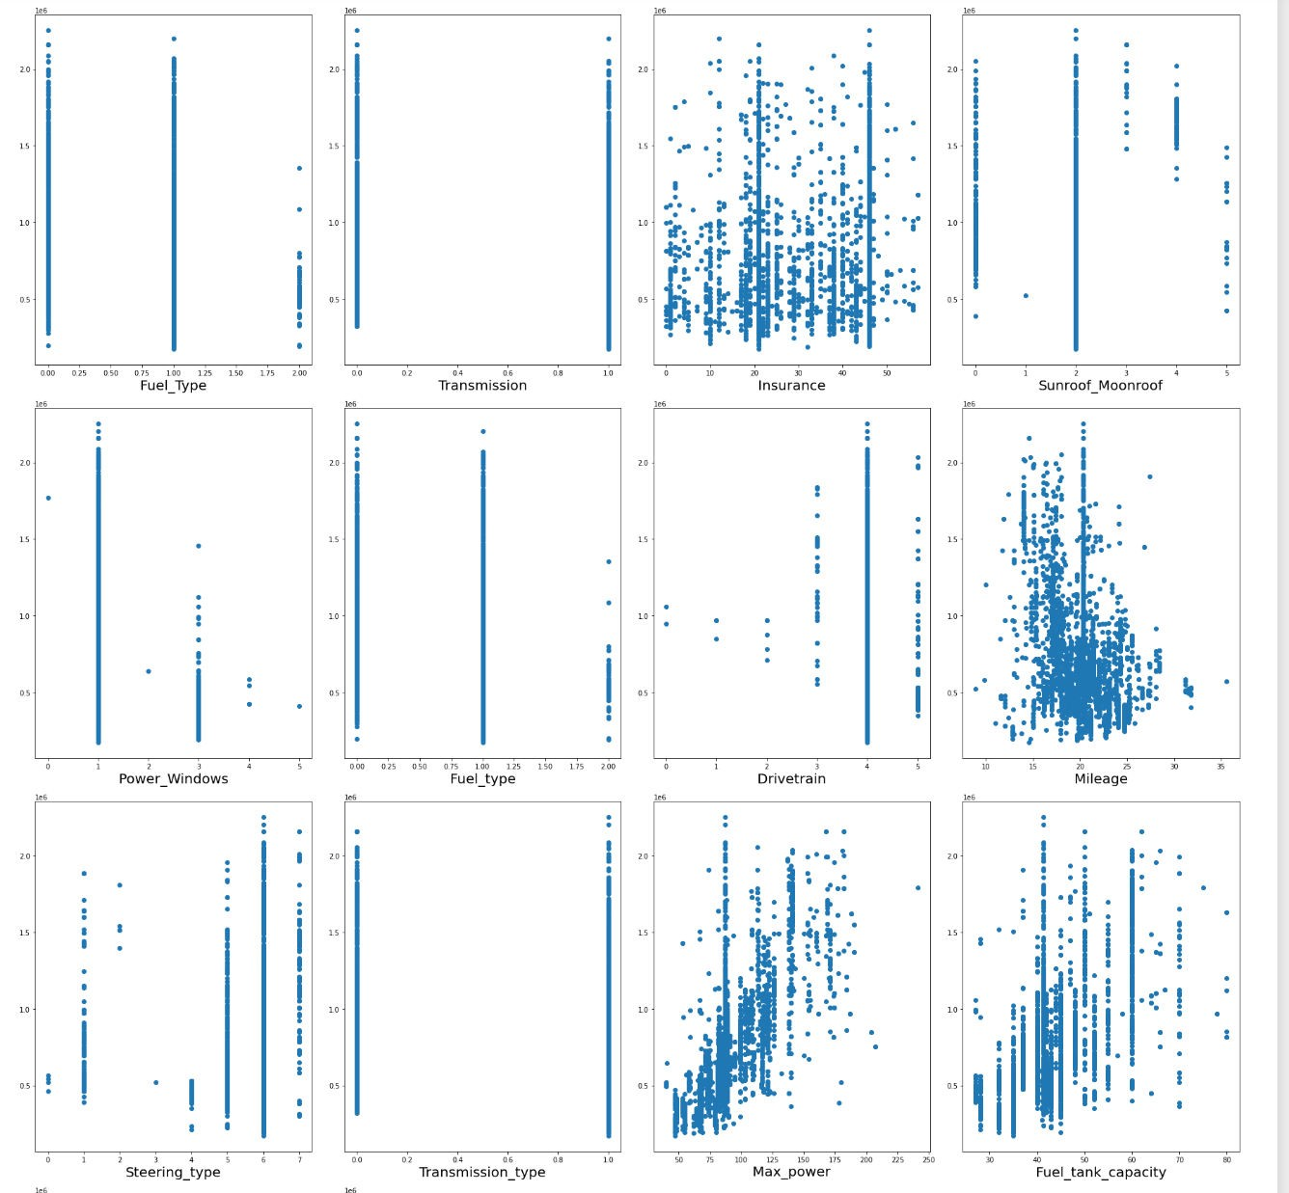
Feature Engg

Slide 9
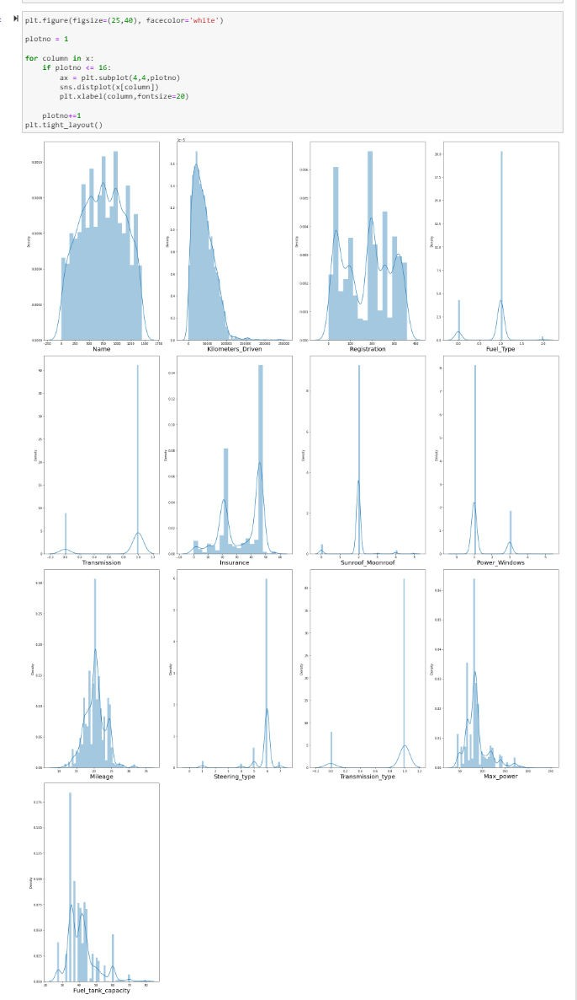
Checking for skew data

Slide 10
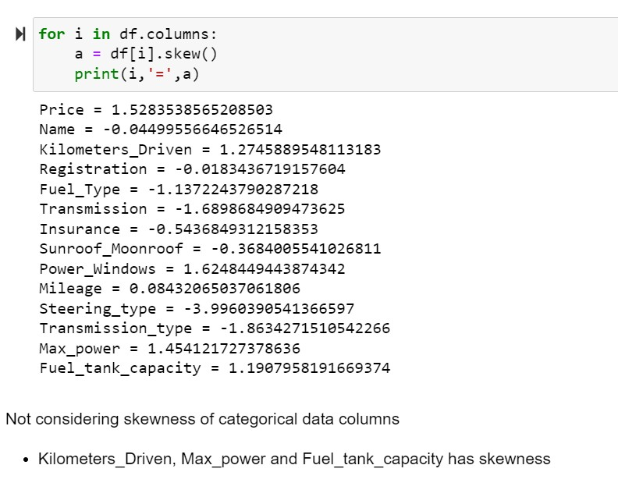
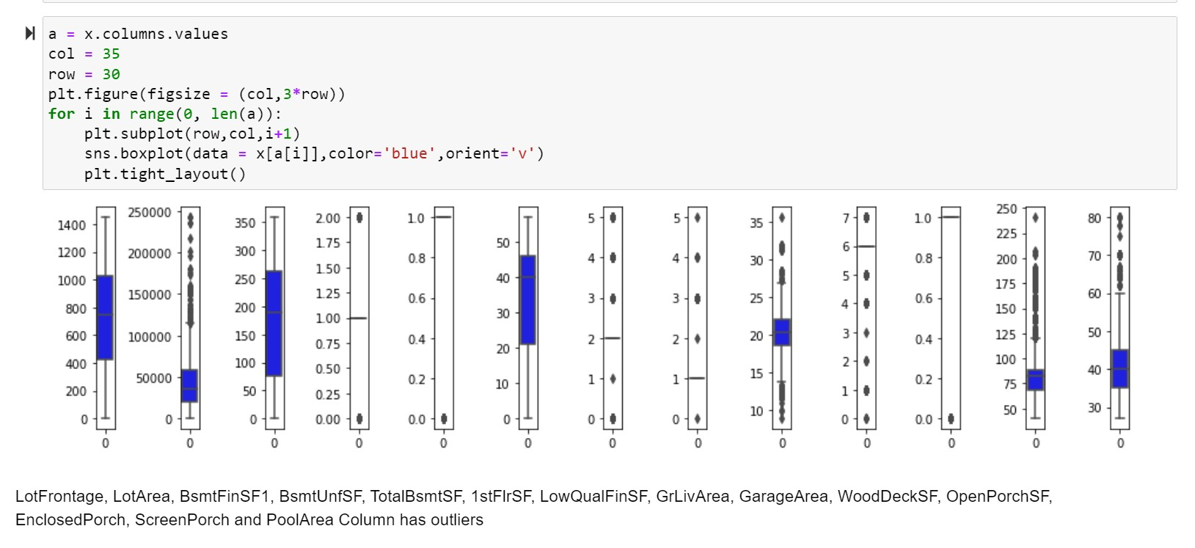
Database is ready to remove outliers if exist
Skewness removed by quantile method
10

Slide 11
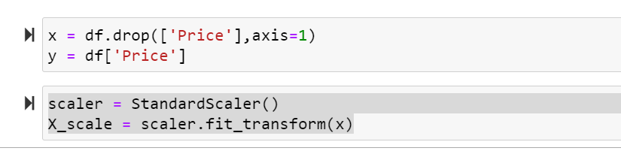
Scaling the data
•

Slide 12
EDA Concluding Remark.
  The information was not organized and coordinated and subsequently cleaned the information utilizing different information cleaning and pre-handling techniques.
  There are numerous anomalies present in the information consequently eliminating exceptions
  There was a skewness in the information thus have eliminated the skewness from the information.
  There was an irregularity in the information thus have utilized SMOTE strategy to balance the information.
  Scaled the data utilizing Standard Scalar to make the information normalized
to fabricate a model.

Slide 13
Hardware and Software Requirements and Tools Used
  Libraries and packages used
import numpy as np - For Numpy work
import pandas as pd - To work on DataFrame
import seaborn as sns - Plotting Graphs
import matplotlib.pyplot as plt - Plotting Graphs
import pickle – To save the Model
from sklearn.preprocessing import StandardScaler (To scale the train data), OrdinalEncoder(To encode object data to Integer), PowerTransformer (To remove skewness from dataset)
from statsmodels.stats.outliers_influence import variance_inflation_factor
enc = OrdinalEncoder() = Assigned OrdinalEncoder to variable
from sklearn.model_selection import train_test_split, GridSearchCV, cross_val_score,(To split the data into train and test, Search the best parameters, to calculate cross validation score)
from sklearn.metrics import accuracy_score, classification_report, confusion_matrix, roc_curve, roc_auc_score - To calculate and analyse model metrics.
from sklearn import metrics
Models which are used
from sklearn.ensemble import RandomForestClassifier
from sklearn.linear_model import LogisticRegression
from sklearn.ensemble import GradientBoostingClassifier
from sklearn.tree import DecisionTreeClassifier
from sklearn.neighbors import KNeighborsClassifier
from sklearn.svm import SVC
import warnings
warnings.filterwarnings('ignore') - To ignore unwanted Warnings
Hardware used – 11th Gen Intel(R) Core (TM) i3-1115G4 @ 3.00GHz GHz with 8.00 GB RAM and Windows 11
Software used – Anaconda and Jupyter Notebook to build the model.
3.00

Slide 14
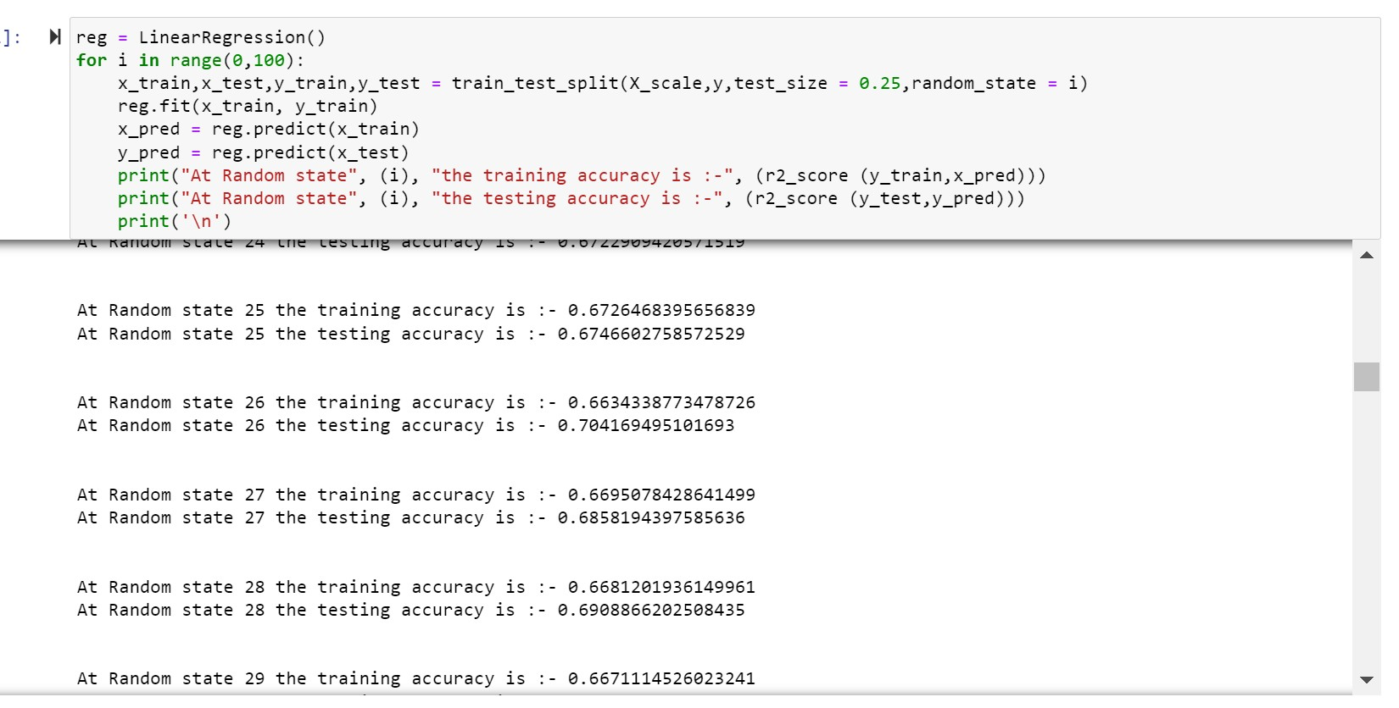
Building Machine Learning Models.
I have built 6 machine learning models to predict the label. Below are the machine learning models which are been used.
LogisticsRegression
RandomForestClassifier
DecisionTreeClassifier
GradientBoostingClassifier
Support Vector Classifier
KNeighborsClassifier
1. LogisticsRegression:
Have used “For Loop” to find out the highest accuracy score with different random state ranging from 0-100 and using that random state to split the data into train and test data.
Have used “Define Function” to define a machine learning model code that automatically provides the train and test accuracy code.
Formulas:
y_pred = clf.predict(x_train) = Predicting train data
accuracy_score(y_train, y_pred) = Calculating train accuracy score (comparing y_pred data with y_train data)

Slide 15
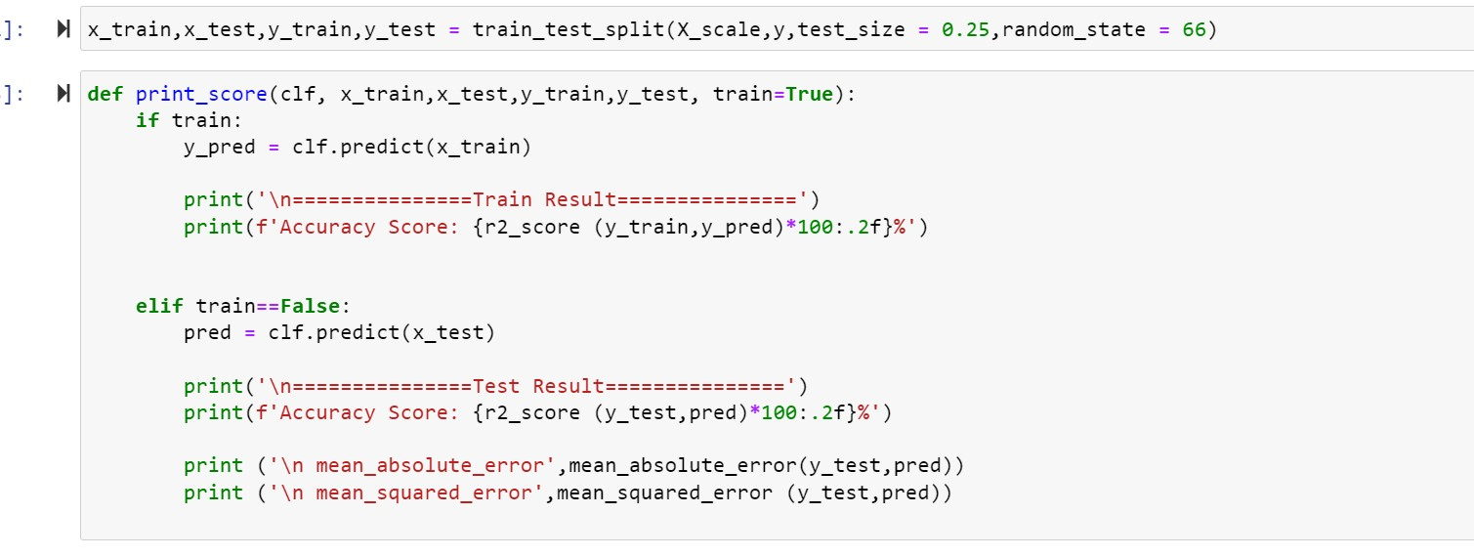
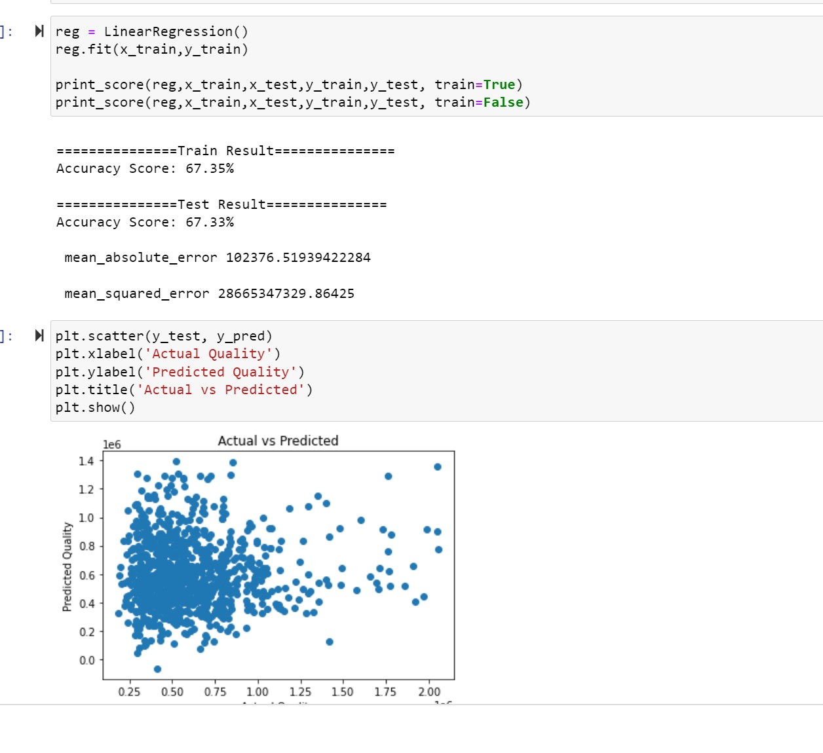
pred = clf.predict(x_test) = Predicting test data
accuracy_score(y_test, pred) = Calculating test accuracy score (comparing pred data with y_test data)
Trained the data and run the “Def” function

Slide 16
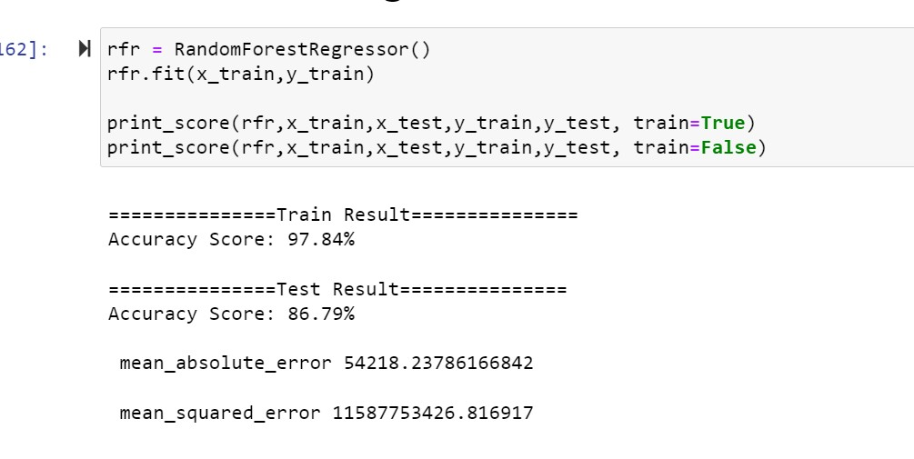
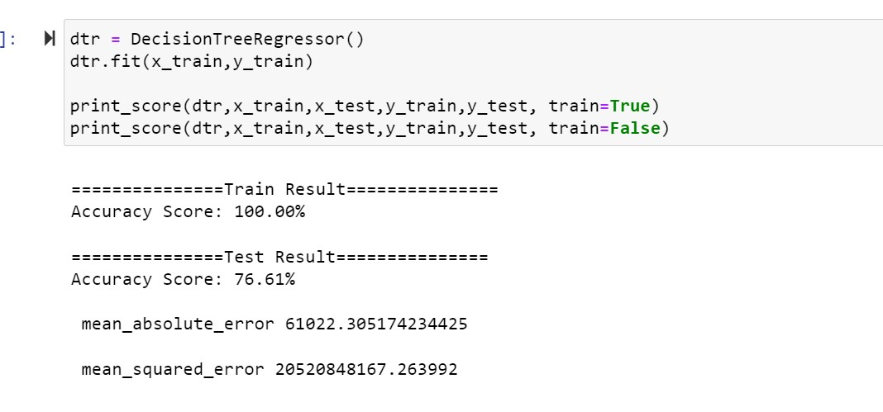
2. RandomForestClassifier:
3. DecisionTreeClassifier:

Slide 17
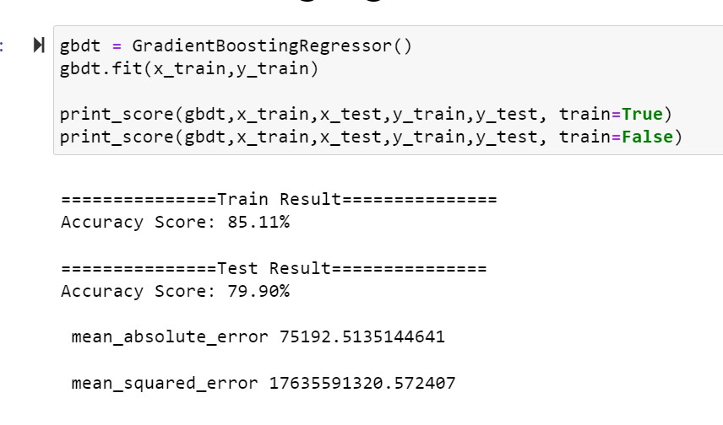
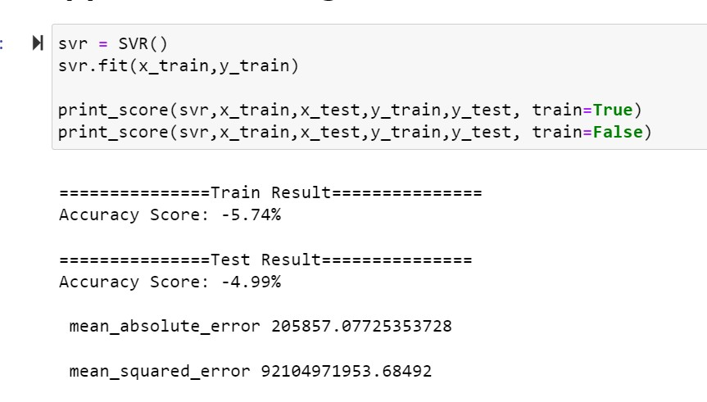
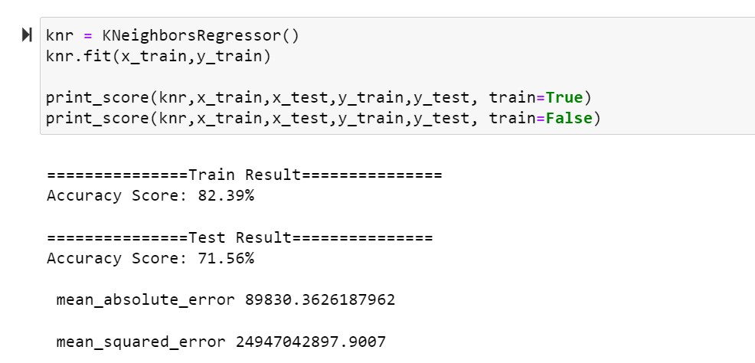
4. GradientBoostingClassifier:
5. Support Vector Classifier:
6. KNeighborsClassifier:

Slide 18
Findings
LinearRegression train accuracy score 67.35% and test accuracy score 67.33%
Support Vector Regression train accuracy score -5.74% and test accuracy score - 4.99%
DecisionTreeRegressor train accuracy score 100.00% and test accuracy score 76.61%
AdaBoostRegressor train accuracy score 57.60% and test accuracy score 55.07%
GradientBoostingRegressor train accuracy score 85.11% and test accuracy score 79.90%
RandomForestRegressor train accuracy score 97.84% and test accuracy score 86.79%
KNeighborsRegressor train accuracy score 82.39% and test accuracy score 71.56%
Model Selection:
LinearRegression it has low variance between train and test result and has high 67.35% and 67.33% accuracy i.e., respectively.

